Slide 1
Triangle Congruence by SSS & SAS

Slide 2
Objectives
State postulates of congruence of triangles correctly.
Apply postulates of congruence of triangles correctly.
Distinguish between SSS and SAS.
Correctly interpret and utilize included sides and included angles.

Slide 3
Side-Side-Side (SSS) Postulate:
If three sides of one triangle are congruent to three sides of another triangle, then the triangles are congruent.

Slide 4
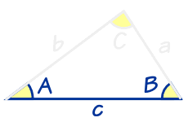
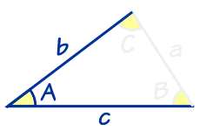
Included Sides and Angles:
In a triangle, we say a side is included if it is between two referenced angles.
In a triangle, we say an angle is included if it is between two referenced sides.

Slide 5
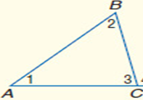
Example
Side AC is included between angles 1 and 3.
Angle 2 is included between sides AB and BC.

Slide 6
Side-Angle-Side (SAS) Postulate:
If two sides and the included angle of one triangle are congruent to two sides and the included angle of another triangle, then the triangles are congruent.

Slide 7
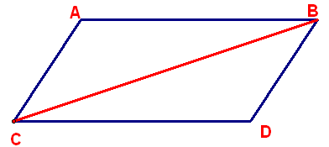
Proof Examples
Given: AB ≅ CD and BD ≅ AC Prove: ΔABC ≅ ΔBDC
AB ≅ CD and BD ≅ AC
Given
BC ≅ BC
Reflexive Property
ΔABC ≅ ΔBDC
SSS

Slide 8
Proof Example
Given: V is the midpoint of RU and the midpoint of ST Prove: Prove: ΔRSV ≅ ΔUTV
V is the midpoint of ST
Given
SV ≅ VT
Definition of Midpoint
V is the midpoint of RU
Given
RV ≅ UV
Definition of Midpoint
∠RVS ≅ ∠UVT
Vertical Angles Theorem
ΔRSV ≅ ΔUTV
SAS

Slide 9
Class Examples:
Decide whether you can deduce by SSS or SAS that another triangle is congruent to ΔABC. If so, write the congruence and name the pattern used. If not, write no congruence.

Slide 10
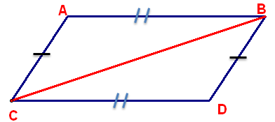
1.

Slide 11
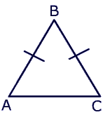
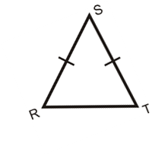
2.

Slide 12
3.

